Slide 1

A/B TESTING
XIAOCEN SHANG
JUN 2020

Slide 2
What is an A/B test? Can we test it on everything?
Wikipedia: Two versions (A and B) of a single variable are compared, which are identical except for one variation that might affect a user's behavior.
Circumstances not suitable for A/B tests
Adding new experience (novelty effect)
Long term effect (learning effect)

Slide 3
Before Applying A/B Test
Sanity Check
Population sizing metrics
unit of diversion comparable to unit of analysis (similar to “unbiased” definition mentioned in TA session)
eg. # users comparable in the control and experiment group since they are randomly assigned
Actual invariant
Not effected by the experiment or will not change
Unit of Diversion
Definition: the unit/ individual subject in an experiment
Eg. # users, # cookies
Unit of Analysis:
Definition: the base unit/ denominator in your metrics
Eg. # page views for CTR

Slide 4
A/B Testing Step 1: Find the Metric
Metrics: used to measure the control group and experiment group
Four commonly used metrics
Sums and counts
Distribution (mean, median, percentiles)
Probability and rates (click-through-probability and click-through-rate)
Ratios defined for the experiment
Test the robustness and sensitivity of the metrics
Robustness: result can stay relatively stable when some modifications are made
Sensitive: result can react to the changes
find a balance between the robustness and sensitivity

Slide 5
Step 2: Choose 𝝰, 𝝱, d, and calculate sample size
Null Hypothese v.s. Alternative Hypothesis
Null Hypothesis: proposes that there is no difference between certain characteristics of a population
Alternative Hypothesis: the one you want to test against the null hypothesis
𝝰, 𝝱, confidence interval
Type I Error 𝝰: prob of rejecting null hypothesis when null is true
Type II Error 𝝱: prob of failing to reject false null
Confidence Interval: (1-𝝰)% of the results will fall in the confidence interval
Power of Test: 1-𝝱
Sample size needed
d: minimum detectable effect
Can be decided based on 𝝰, 𝝱, d, and sample standard error (or conversion rate)

Slide 6
Step 3: Design and Run the Test
Population
Inter-user or Intra-user?
Inter-user: different population for A/B group
Intra-user: same population for A/B group
Cohort
Only look at population with same characteristics
Eg. Same region, same experiment time interval
Size
Duration and Exposure
2-4 weeks according to TA session
Reason for not use a single day data
Different patterns for weekdays, weekends, and holidays
Thing to keep in mind
Learning Effect

Slide 7
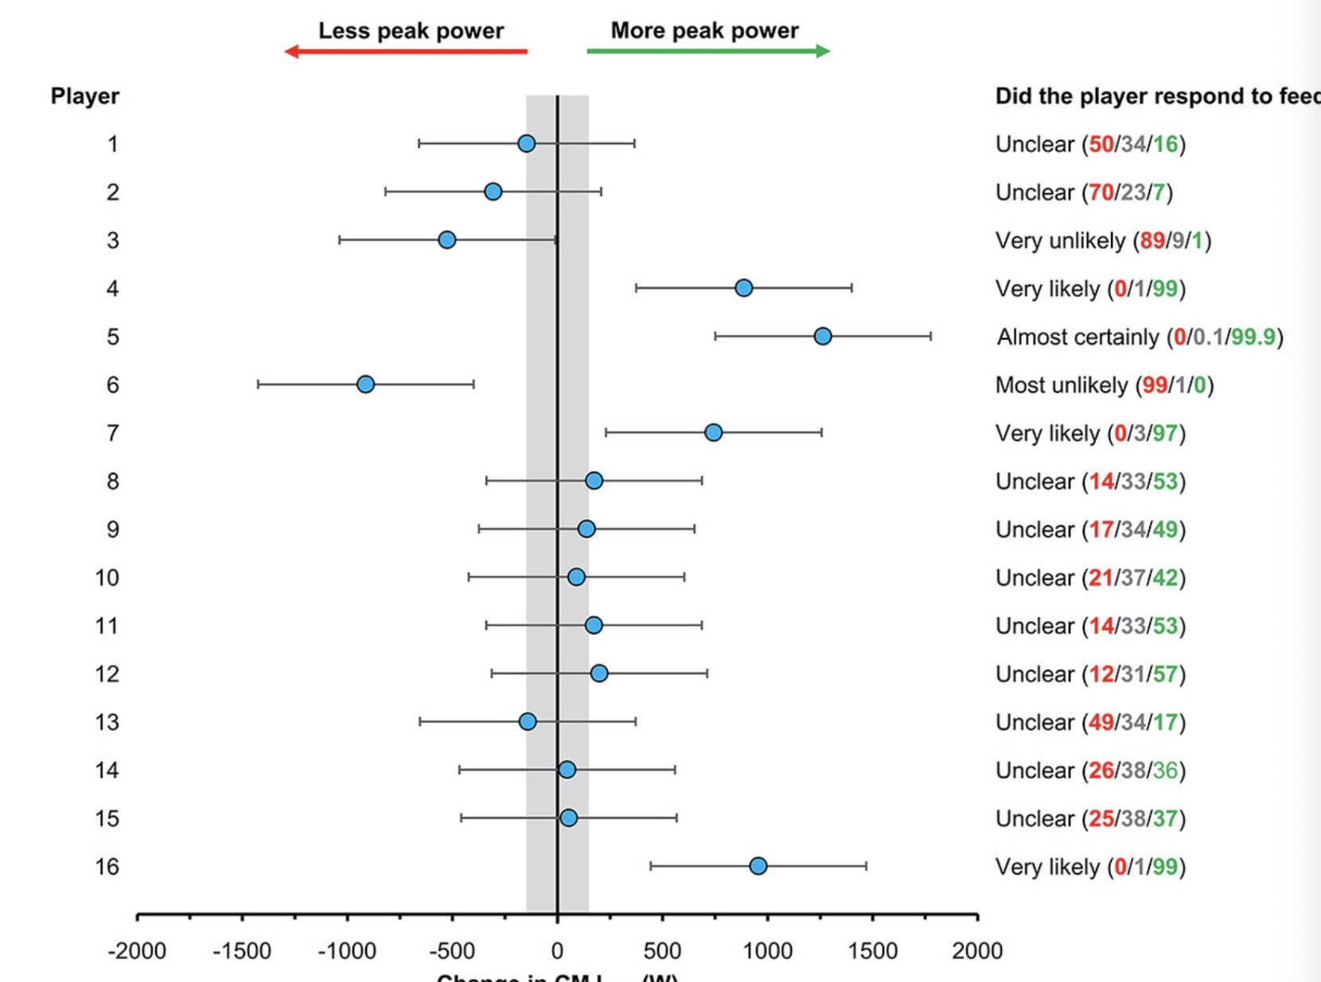
Step 4: Analyze the Results and make conclusion
Single metric
Significance or not?

Slide 8
Step 4: Analyze the Results and make conclusion
Single Metric but not statistically significant
Split using different cohort
Eg. time/ platform/ region
Use different methods
Use different methods for hypothesis testing (different distribution, non-parametric)
Multiple Metrics
May see significant result by chance
Ways to solve
Boostrap
Bonferrorni correction
Familywise Error Rate
False Discovery Rate

